Slide 1

SUGCON Europe 2025
A Look into the Future of Sitecore

Slide 2

Nona Dzhurkova
Sitecore Technology MVP 2025 Senior Architect & Sitecore Team Lead Email: nona.dzhurkova@americaneagle.com

Slide 3
How It All Started
The journey to SUGCON Europe 2025 started long before April. As early as January, preparations were already underway — requesting approvals for the company trip, arranging flights and hotels, and selecting the sessions we wanted to attend. The excitement steadily built as the countdown to Antwerp began

Slide 4
3 days before the conference
On 31 March 2025, a one‑day nationwide strike in Belgium halted all departing flights at Brussels and Charleroi Airports—just 2 days before our flight - SUGCON Europe began on April 3.

Slide 5
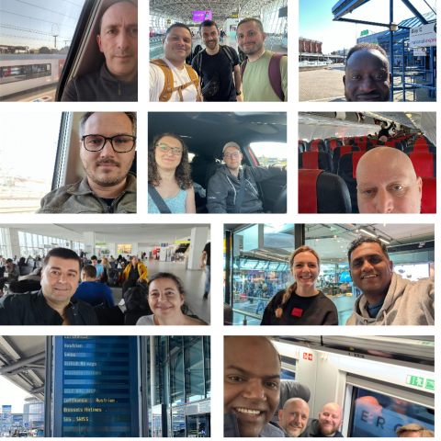
The Travel Day
WhatsApp group

Slide 6

Welcome to Antwerp
Antwerp is known as the diamond capital of the world — and it definitely shines.
From the stunning Antwerp Central Station to cozy cafés and historical streets, the city offered the perfect backdrop for SUGCON Europe 2025.

Slide 7
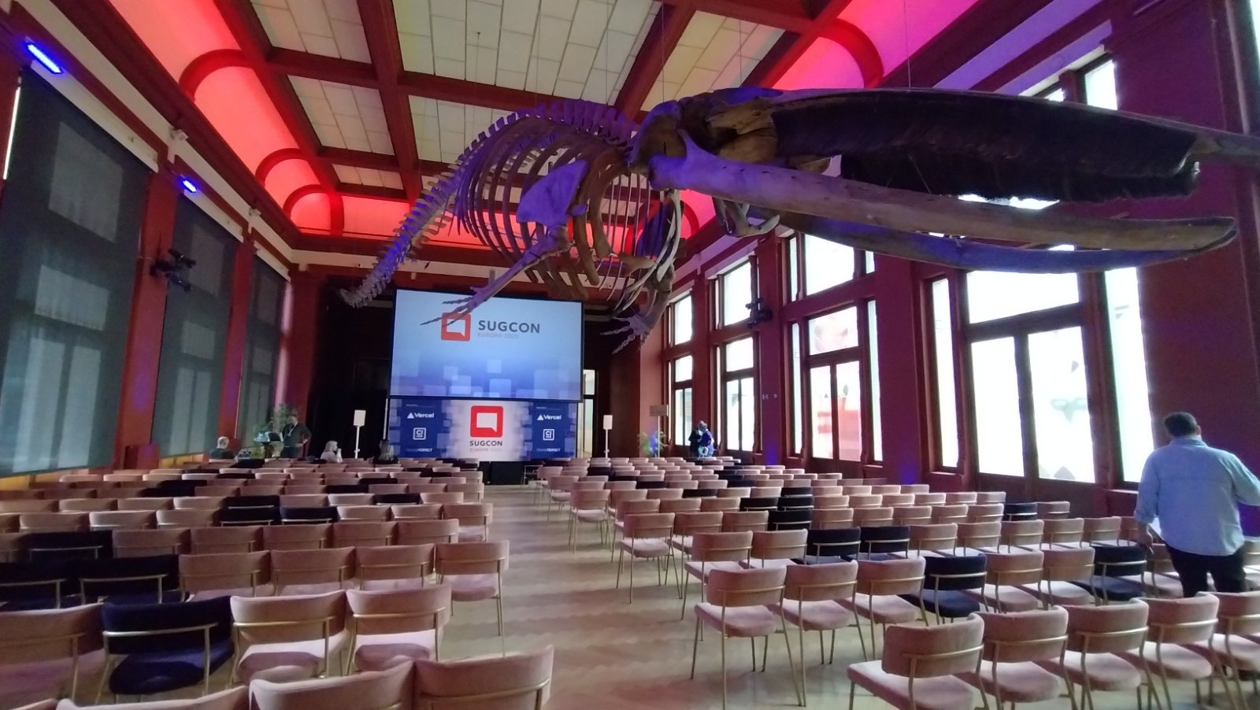

The Venue – A Room with A Zoo

Slide 8
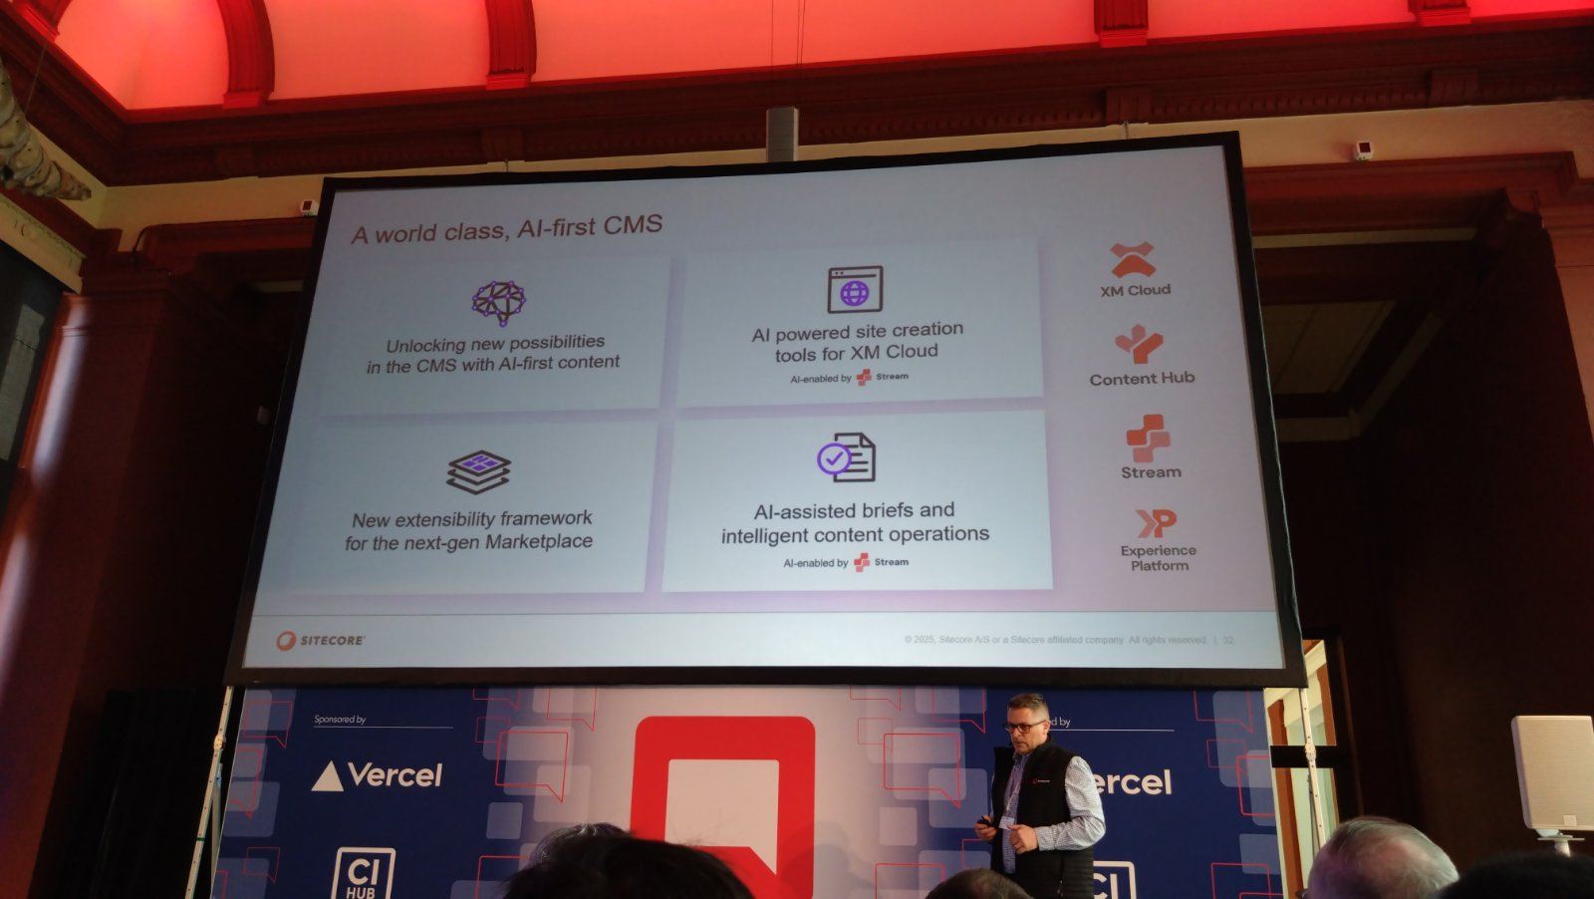
Keynote – Powering the Future of Sitecore Together
AI is now central to Sitecore’s platform strategy. Sitecore Stream was introduced as the capability that brings intelligence across the full product range, including XM Cloud, XP and XM, Content Hub, and CDP.

Slide 9
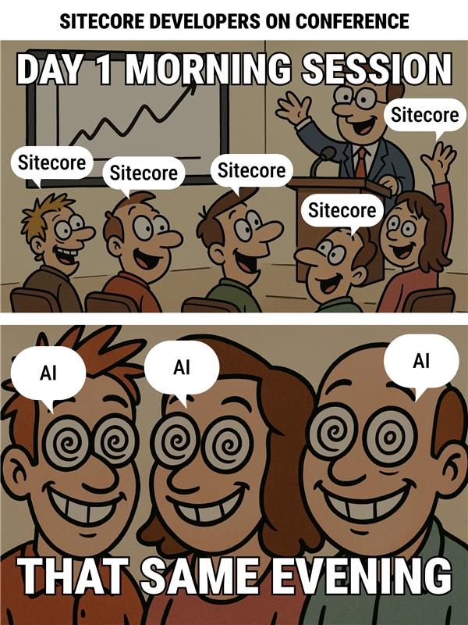
The reality

Slide 10
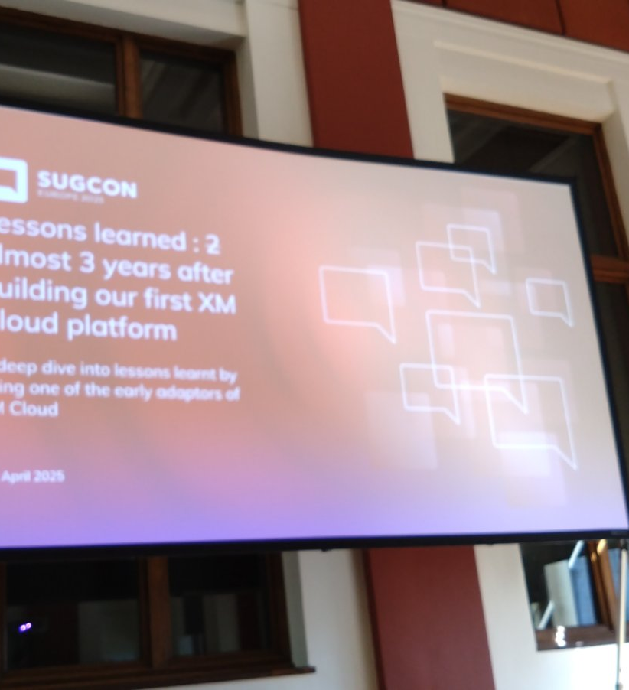
Lessons learned: 2 years after building our first XM Cloud by Derk Hudepol
This session shared lessons from nearly three years of working with XM Cloud in a real-world, high-traffic setup. It covered technical decisions, growing pains, and how the team adapted as the platform evolved.
Figma driven deployment
800% Productivity Increase, 390% Mobile Page speed Increase
Moving to Monorepo
JSS Upgrades
Edge Limitations
Vercel performance
Publishing
Search
XM Changelog

Slide 11
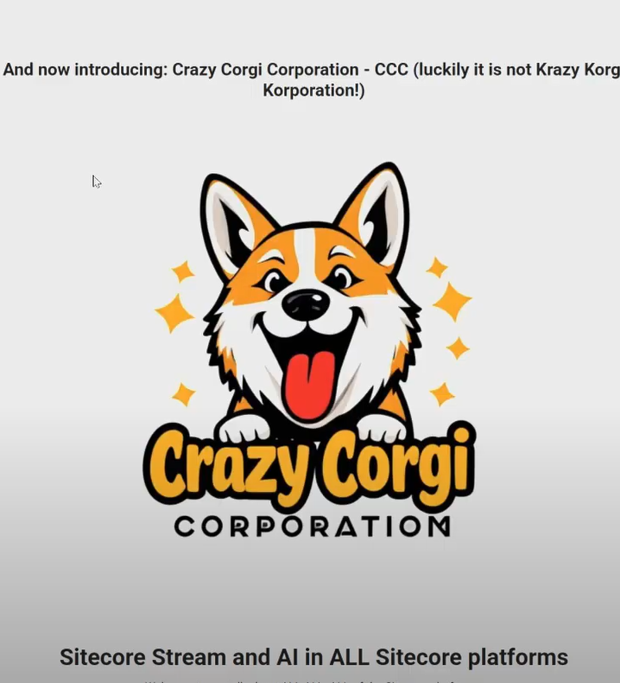
30 min of AI in Sitecore by Morten Ljungberg
Live Demo The session will take you through all AI which is currently in all Sitecore platforms + what is just around the corner
AI Integration – across Sitecore platform
Sitecore Stream – brand-aware intelligence
AI Agents and Copilots - content creation

Slide 12
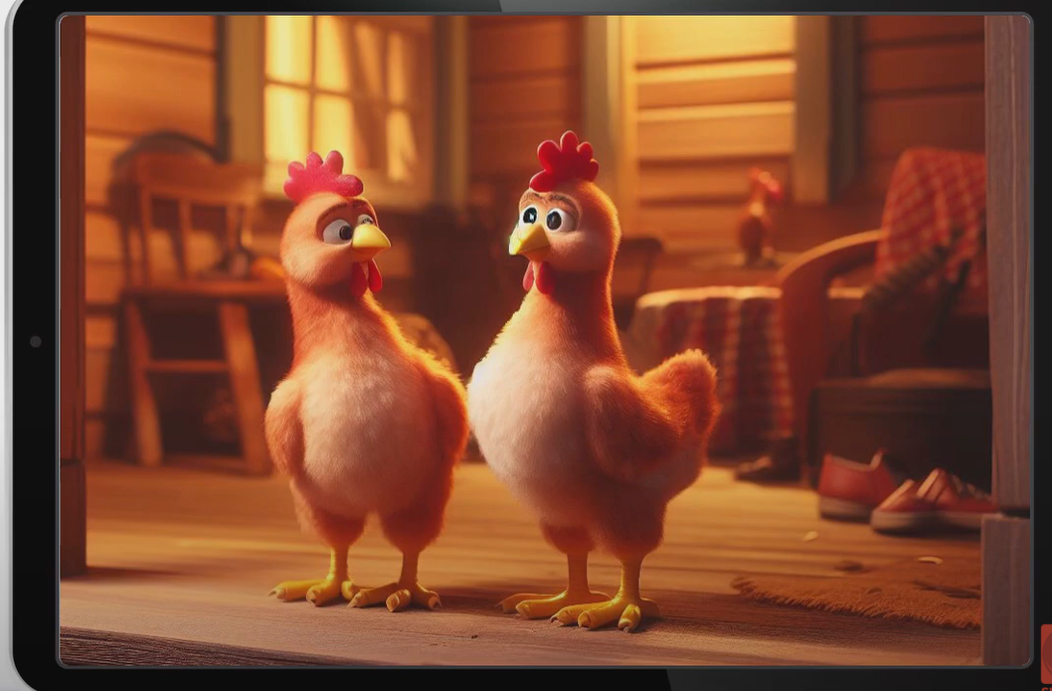
The joys and challenges of managing thousands of websites by Adam Najmanowicz
Learn how incredibly scalable Sitecore is and what you can expect when you have thousands of websites in your instance.
Virtual Content
Shared site
Segments for Shared Content
Brand organized in counties
Virtual Pages
Content tokens

Slide 13
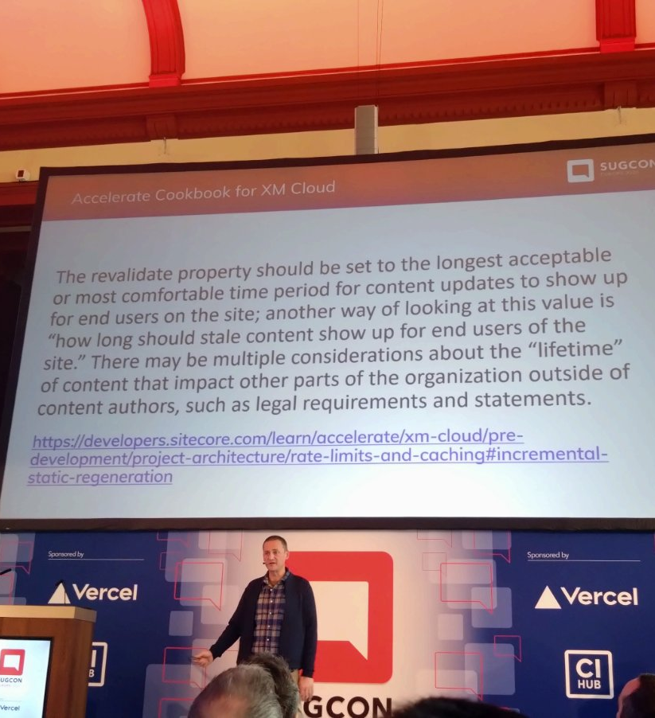
Full Circle: The Architect of XM Cloud builds an XM Cloud Site by Andy Cohen
Andy Cohen, the architect behind XM Cloud, embarked on a unique journey to build a site using the very platform he helped design.
Unexpected Challenges
Lessons Learned
Identified Improvements
Feedback Loop
Commitment to Excellence

Slide 14
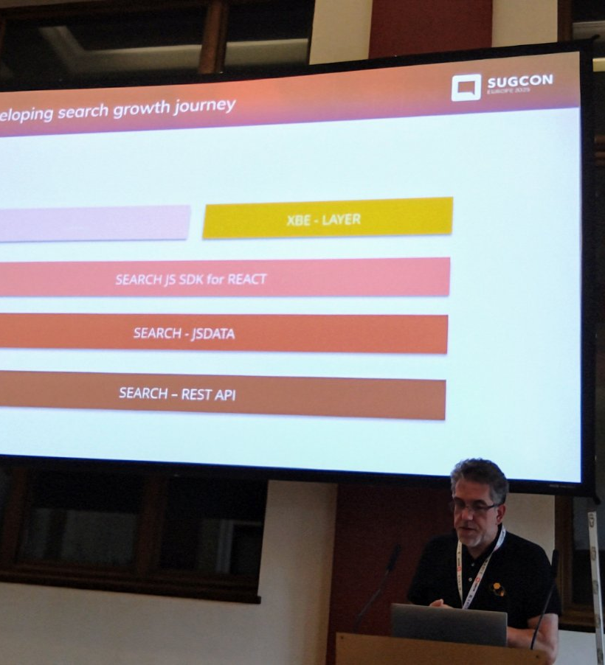
Unlocking the Power of Sitecore Search by Jeroen Speldekamp
Sitecore Search is more than just search functionality
Real-World Implementation
Challenges and Solutions
Optimization
Customization

Slide 15
Sitecore Marketplace
Sitecore Marketplace is a centralized platform designed to enable developers, partners, and customers to extend and customize Sitecore products in a self-service, API-first, user-centric environment.
Touchpoints with Sitecore Saas Products - Now – Portal, XM Cloud, Next - CH, CDP, Unified API Layer – SDK, Private or Public
https://github.com/Sitecore/marketplace-sdk
The new (not JSS) Content SDK
The new Content SDK will replace the JSS SDK for XM Cloud products. (It will not be compatible with XM/XP Headless solutions)
The JSS SDK just had a major spring cleaning — fewer files, less code, and dropped support for Experience Editor compatibility.
https://github.com/Sitecore/content-sdk BETA!

Slide 16
Sitecore XM Cloud Content
Previously known as Content Hub One, this new backend is set to become the core infrastructure for content storage and delivery within XM Cloud, operating entirely as a SaaS solution.
During the demonstration, we were shown the full content lifecycle—from modeling the structure to real-time consumption. What stood out was the system’s impressive responsiveness. Content retrieval is fast and efficient, powered by GraphQL, with built-in query suggestions that streamline development and further accelerate performance
Sitecore 10.5
Sitecore 10.5 is on the way! There’s a strong commitment to continuing XM/XP

Slide 17
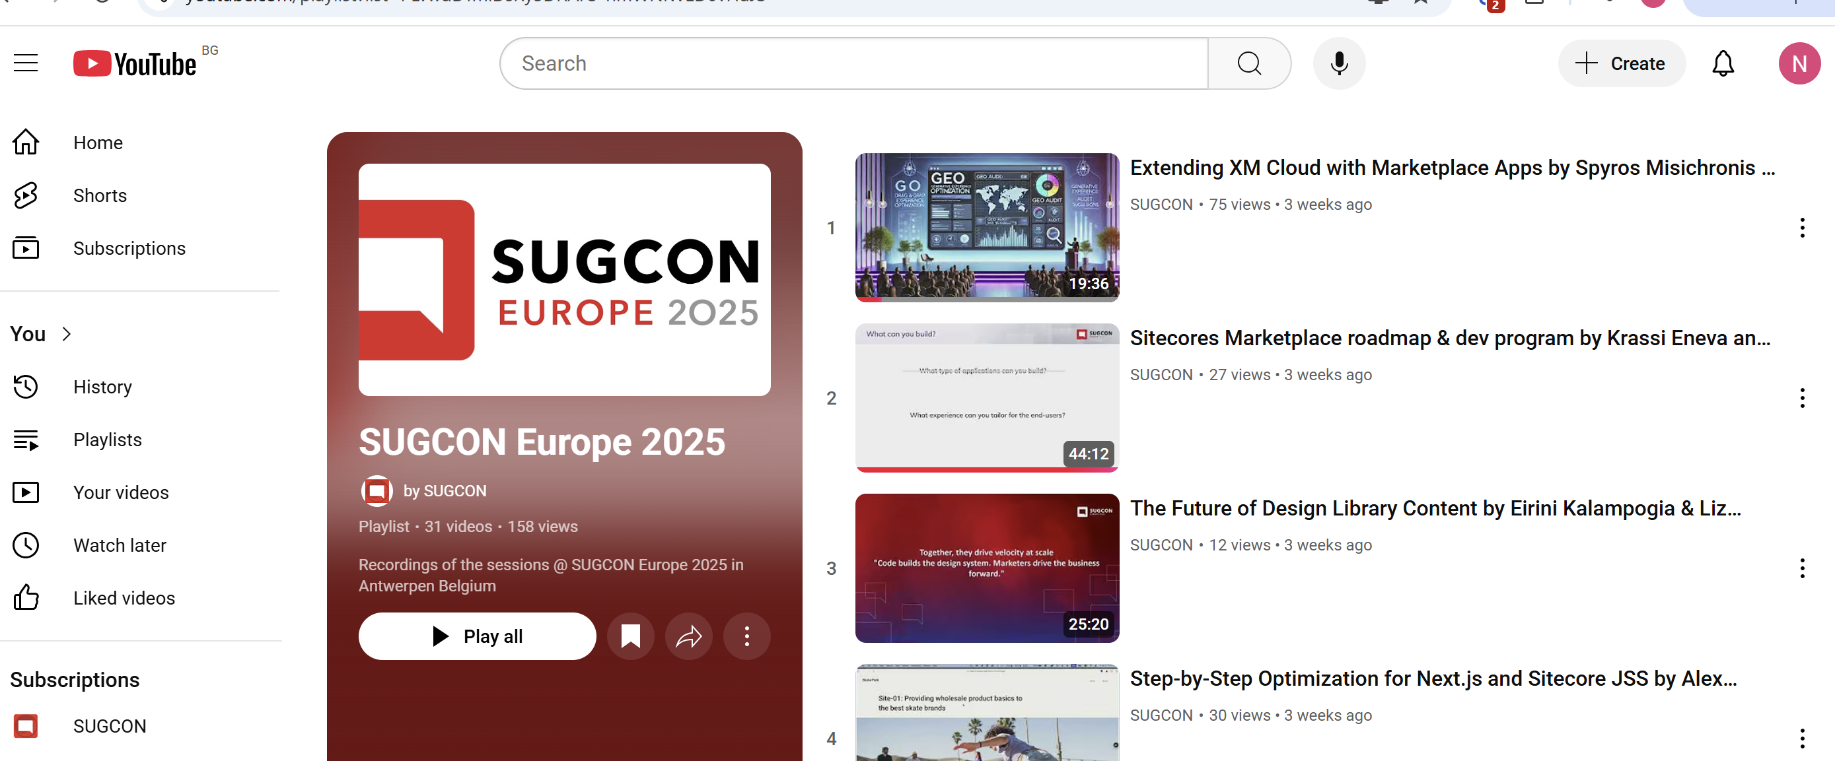
Sessions in YouTube

Slide 18
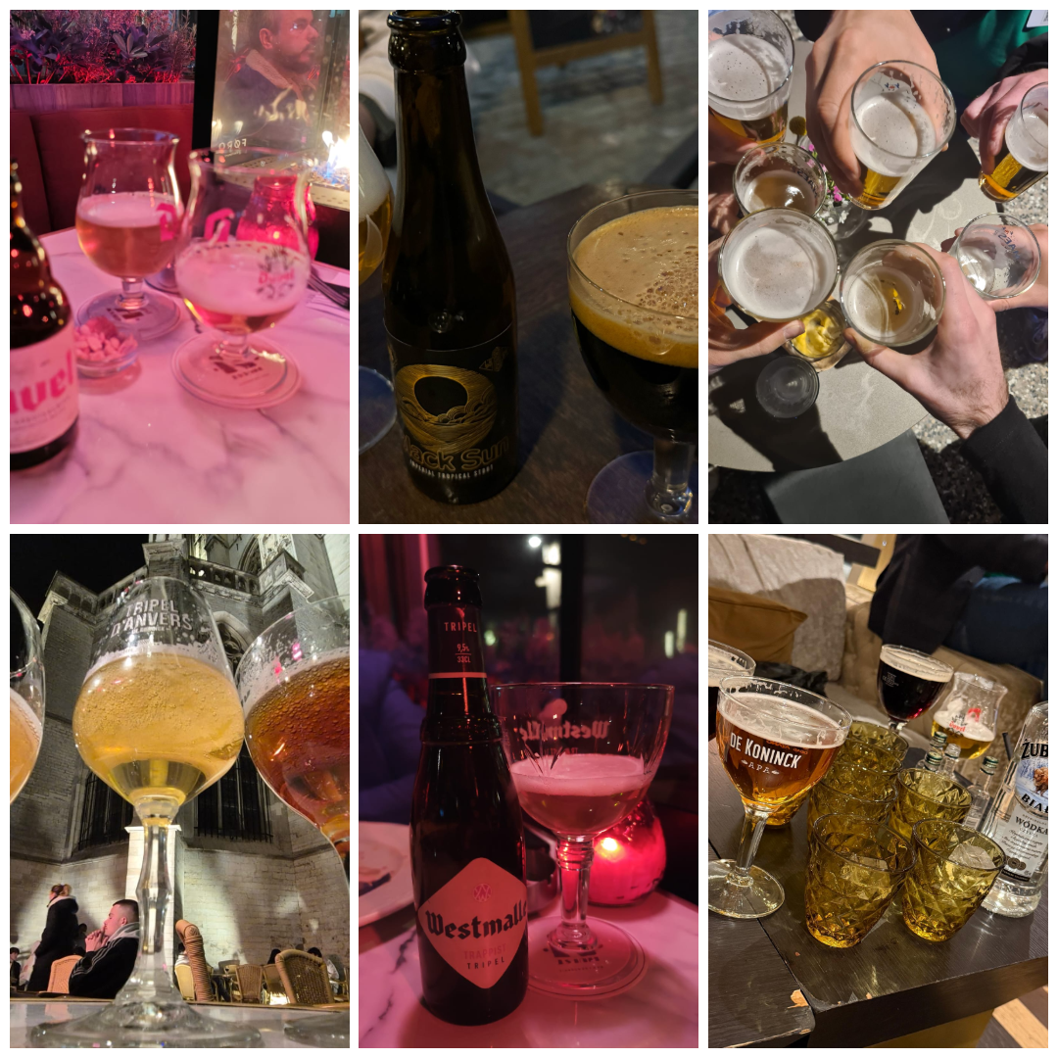
Q&A

Slide 19
Yes, we’ll build and launch a site today
From local setup to global deployment with Next.js & Vercel

Slide 20

Sitecore Sofia User Group
https://sitecore-sofia.vercel.app/

Slide 21
Live Demo

Slide 22
Can You Find the Easter Egg?
We've hidden a small surprise on the site we’re launching today — a little Easter egg.
What’s an Easter egg?
In web development, it's a hidden feature, message, or fun interaction tucked away for curious users to discover.
Can you spot it?
https://sitecore-sofia.vercel.app/

Slide 23
Vercel AI: Build Smarter, Faster
A modern toolkit for creating AI-powered web apps — seamlessly integrated with Next.js, Edge Functions, and popular LLMs.

Slide 24
THANK YOU

